Slide 1
Fanex Generator
The tool for project using Fanex.Data to generate DTO, Criteria class and Stored Procedure Parameter
R&D Team - Edward.Nguyen

Slide 2
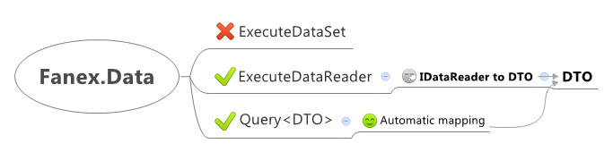
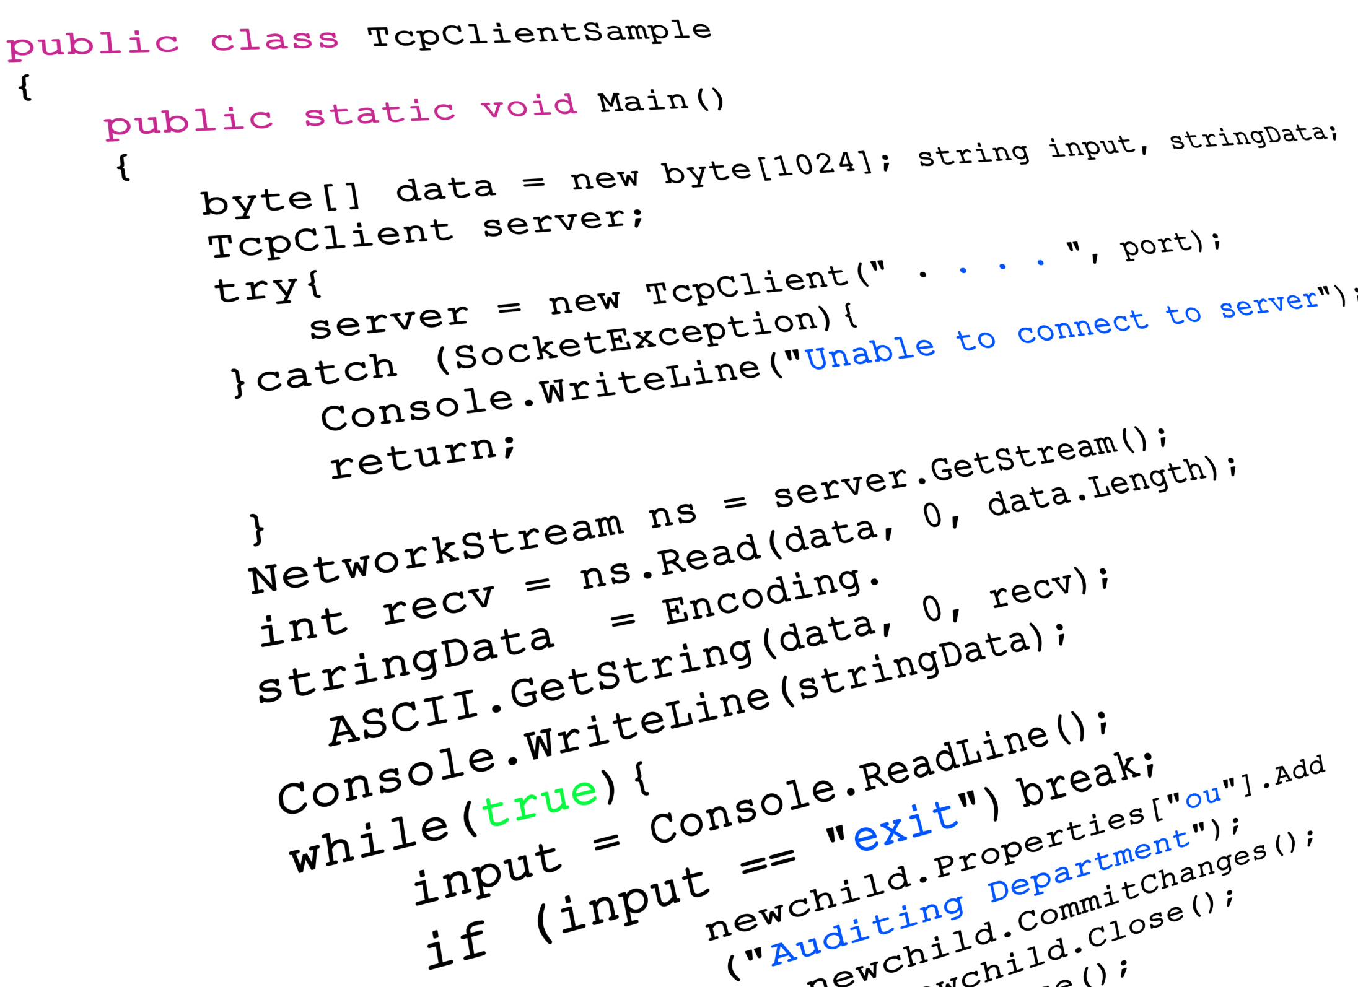
What’s it do ?
Generator
Generator
Generator
Database
storedprocedure([paramaters])

Slide 3
DEMO
Generate DTO
Generate Commands Map IDataReader to DTO
Generate query object

Slide 4
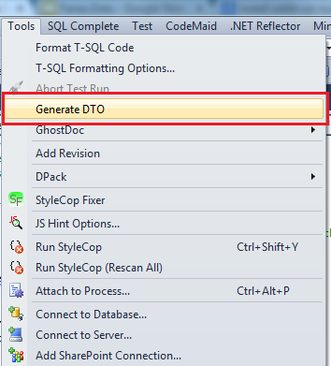
Where I can find it ?
Begin by opening any document file on your solution. Next in Visual Studio, from the Tools menu select Fanex.Generator (Ctrl+Shift+G)

Slide 5
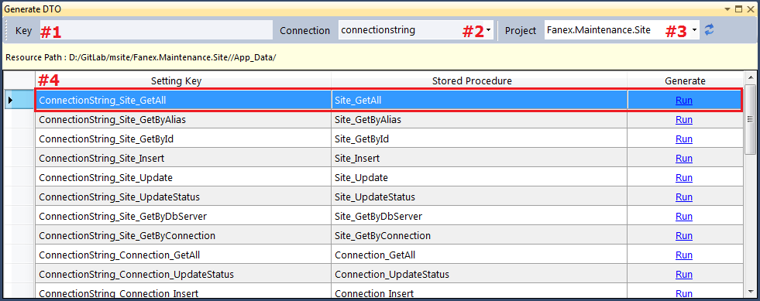
The Generate DTO dialog box is displayed
#1 Enter the setting key you want generate (The searching information will be shown below) #2 Connection string name (The stored procedure belong to the connection string name) #3 Project in your solution #4 Select the specific stored procedure you want generate and click on Run or double click on current row

Slide 6
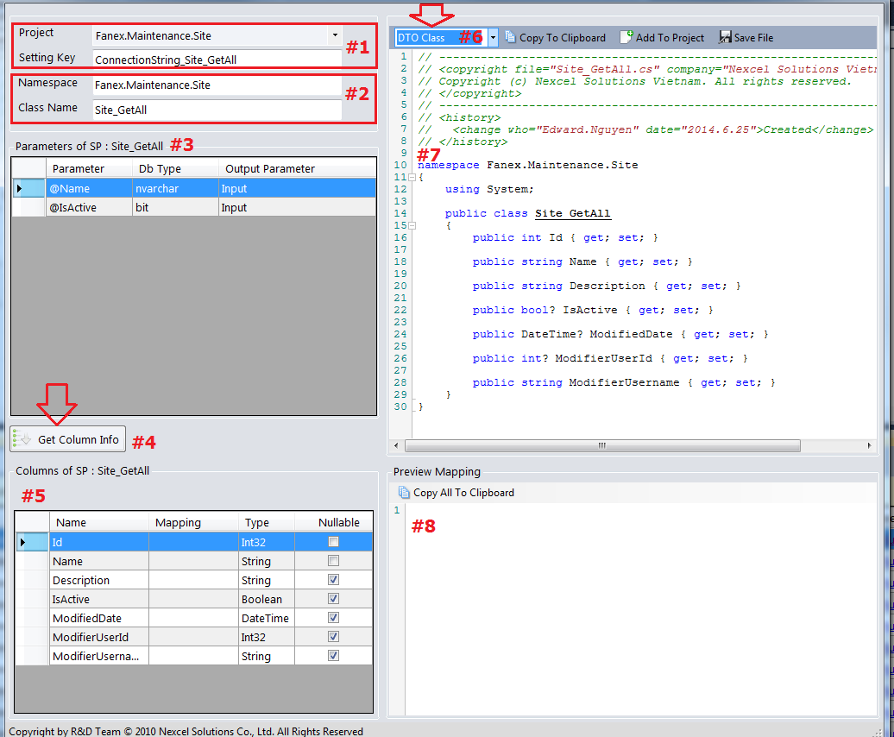
#1 Search another setting key #2 Specific namespace, class name for the DTO class #3 Parameter information of stored procedure #4 Click here to get column information from stored procedure
#5 The column information of stored procedure after click Get Column Info
#6 Select type you want generate
#7 The content generate
#7 Mapping column for Sp name file

Slide 8
How to install it ?
Download here

Slide 9
Q&A
Thank you

